Slide 1
Managing Change

Slide 2
Managing Change
Businesses operate in an ever changing environment
Change can come from outside the business or from within
The ability to anticipate, prepare for and respond to change is essential for a business to remain competitive

Slide 3
Change
There are four main types of change:
Rapid and unexpected
Long term
Incremental
Disruptive
There are also predictions of further future disruptive change

Slide 4
Change – Rapid and Unexpected
Change may be rapid and unexpected
For example, sudden bad weather conditions affecting supply
This could affect agricultural products such as coffee or fruit and veg

Slide 5
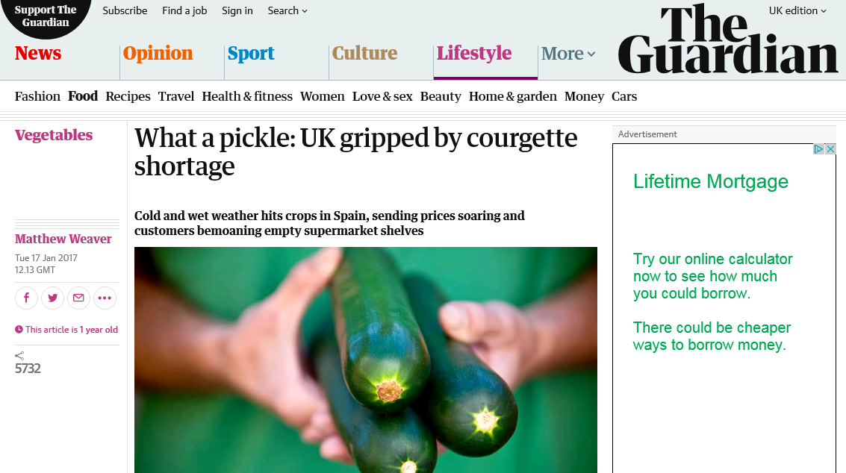
Change – Rapid and Unexpected

Slide 6
Change – Long Term
Change may be long term
This could include the shift in economic power towards economies in Indi and China
Or this could include ageing populations in the UK and Japan
These are shifts that are predictable in terms of how they are developing and therefore managers have more time to prepare

Slide 7

Change – Long Term
Example of changing UK population
Office of National Statistics:
“16% of UK population is over 65”
“When we consider those who reach over 85 years old, the proportion of this population is smaller. In 1996 there were no local authorities with more than 3% of their population aged 85 and over. In 2006, most authorities had 2% to 3% of their local population aged 85 and over. In 2016 over half of local authorities had over 3% of their population aged 85 and over. This is projected to continue increasing, with very few authorities below 3% in 2026 and below 4% in 2036.”

Slide 8
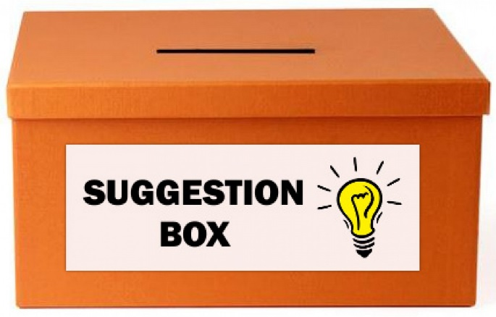
Change – Incremental
Change may be incremental – i.e. step by step change. Most businesses will gradually improve their processes over time.
Staff or customers will have small suggestions for change and can incrementally build and improve the business over time.

Slide 9

Change – Incremental
Think about Kaizen groups, quality circles and Toyota.
Also consider customer feedback, sales patterns and identifying trends.

Slide 10
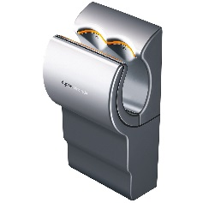


Change – Disruptive
Change may be disruptive – this refers to ‘game changing‘’ developments in an industry.
Think of the Dyson launching a bagless vacuum cleaner or the Airblade hand-dryer
Think of the impact of email on the postal service
Think of how Amazon has challenged the book retailing industry

Slide 11






Change – Disruptive
The following images are also examples of businesses that have resulted in disruptive change

Slide 12
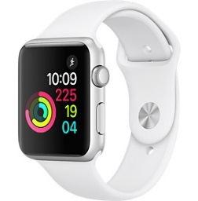

Future Disruptive Change?
Future disruptive change is expected, for example:
The development of new applications that collect, report and respond to information from our own bodies. Apps will track our health and flag when and what we need, thereby affecting the healthcare industry. This has started already with the likes of Apple Watch and Fitbit

Slide 13
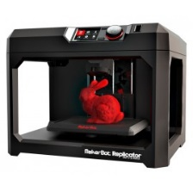
Future Disruptive Change?
Future disruptive change is expected, for example:
3D or additive manufacturing is the process of making three-dimensional solid objects from a digital file of data. In an additive process, an object is created by laying down successive layers of material until the entire object is produced. With traditional product you need to set up the production equipment and tools to product a particular design, having to set up these tools is an expensive process.
With 3D printing businesses can increase their flexibility with less production time, being able to make one-off personalised product and there are lower set up costs. This could lead to new entrants.

Slide 14

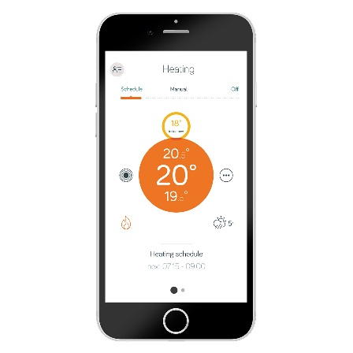
Future Disruptive Change?
The Internet of Things – this is technology in which everyday items became fitted with the ability to collect, send and receive information. The idea behind this is to connect any device to the internet and to each other including mobile phones, thermostats, fridges, washing machines etc.

Slide 15
Task
Investigate one type of change.
Create a poster for the rest of the class to gain information from.
Identify the type of change and the impact of future disruptive change
Explain what each type of change means
Provide at least one example of this type of change and analyse the impact this has had on the business world

Slide 16
Internet and Change
An analyst from the firm Gartner says that by 2022 there will be over 26 billion connected devices
This could mean…
Your printer will know when it is running out of ink and reorder for you
You car might know it is due a service
Your heating systems knows to change the temperature
Billboards could change their adverts as you drive past
Your TV will recommend what you should be watching and automatically record things you might like

Slide 17
Internet and Change – Imagine!
You set your alarm for 7am
This automatically sets your heating to come on at 6am
It also automatically sets the kettle to come on at 6.55am
When you make your tea and use up all the milk, the fridge will send the empty shelf and reorder milk for you on your shopping app
The app will access your calendar and find a suitable to deliver to you

Slide 18
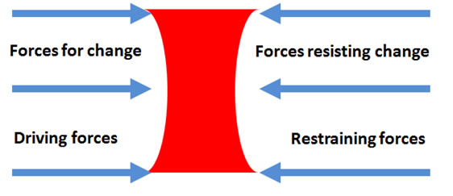
Lewin’s Force Field Analysis Model of Change
Force-field analysis is a development in social science. It provides a framework for looking at the factors that influence a situation, originally social situations. It looks at forces that are either driving movement toward a goal or blocking movement toward a goal.

Slide 19


Slide 20
Change Management
Managers should be constantly monitoring the changes that are relevant to their industry, as well as facing internal pressures for change such as employees wanting to implement new plans
However, managers are often too busy with their day job to appreciate exactly what is happening and just because there are pressures to do something does not mean it will automatically happen – e.g. how long have they been talking about a new runway at Heathrow?!

Slide 21
The Push for Change
This is because whilst some forces may be pushing for change, other forces will be pushing back to keep things as they are
At any moment a business is likely to be in a position of equilibrium – staying as it is

Slide 22
Why Change?
Remember that:
Change is the result of dissatisfaction with present strategies (performance, failure to meet objectives etc)
Change doesn't happen by itself - it is essential to develop a vision for a better alternative
Management have to develop strategies to implement change
There will be resistance to change - it is inevitable, but not impossible to overcome
Many factors drive change in a business. In his model Lewin identified four forces.

Slide 23
Lewin’s Force Field Analysis Model
Force field analysis provides an overview of the change problems that need to be tackled by a business, splitting factors into forces for and against change
Current State

Slide 24
Task
What do you think?
Decide two forces pushing for change and two forces that could be resisting change

Slide 25
Forces for Change - Internal
Internal forces for change (from within the business or organisation)
A general sense that the business could "do better"
Need for higher profits
Poor efficiency and competitiveness
Lack of innovation
Natural ageing and decline in a business (e.g. machinery, products)
Conflict between departments
The need for greater flexibility in organisational structures
Concerns about ineffective communication, de-motivation or poor business relationships

Slide 26
Forces for Change - External
External forces for change (outside the control of the business / organisation)
Increased demands for higher quality and levels of customer service
Uncertain economic conditions
Greater competition
Higher cost of inputs
Legislation & taxes
Political interests
Ethics & social values
Technological change
Globalisation
Scarcity of natural resources
Changing nature and composition of the workforce

Slide 27
Restraining Forces
Parochial self interest
Individuals are concerned with the implications for themselves; their view is often biased by their perception of a particular situation
Habit
Habit provides both comfort and security
Habits are often well-established and difficult to change
Misunderstanding of the need for or purpose of change
Communications problems
Inadequate information
Low tolerance of change
Sense of insecurity

Slide 28
Restraining Forces 2
Different assessment of the situation
Disagreement over the need for change
Disagreement over the advantages and disadvantages
Economic implications
Employees are likely to resist change which is perceived as affecting their pay or other rewards
Established patterns of working and reward create a vested interest in maintaining the status quo
Fear of the unknown
Proposed changes which confront people tend to generate fear and anxiety
Introducing new technology or working practices creates uncertainty

Slide 29
Organisational Restraining Forces
Structural inertia
Existing power structures
Resistance from work groups
Failure of previous change initiatives

Slide 30
Is Poor Management a Restraining Force?
Change can also resisted because of the poor way in which change is managed!
For example, a failure by management responsible for the change to:
Explain the need for change
Provide information
Consult, negotiate and offer support and training
Involve people in the process
Build trust and sense of security
Build employee relations
As a result of change resistance and poorly managed change projects, many of them ultimately fail to achieve their objectives.

Slide 31
Uses of Lewin’s Force Field Analysis
Lewin's analysis can be used to:
Investigate the balance of power involved in an issue
Identify the key stakeholders on the issue
Identify opponents and allies
Identify how to influence the target groups

Slide 32
Activity
Complete the following table with your thoughts regarding the value of change, the value of a flexible organisation and the value of managing information and knowledge
Value of Change | Value of a Flexible Organisation | Value of Managing Information and Knowledge

Slide 33
Value of Change
Some change can be positive for individuals and organisations:
Some change can bring positive benefits – e.g. economic recovery means higher levels of customer confidence and higher spending
Some change may be foreseeable and therefore managers can prepare for it – e.g. the ageing population creating new opportunities
Some businesses may lead change. Companies such as Uber and Dyson deliberately try to change the types of products we use and the way we work – change creates new possibilities

Slide 34

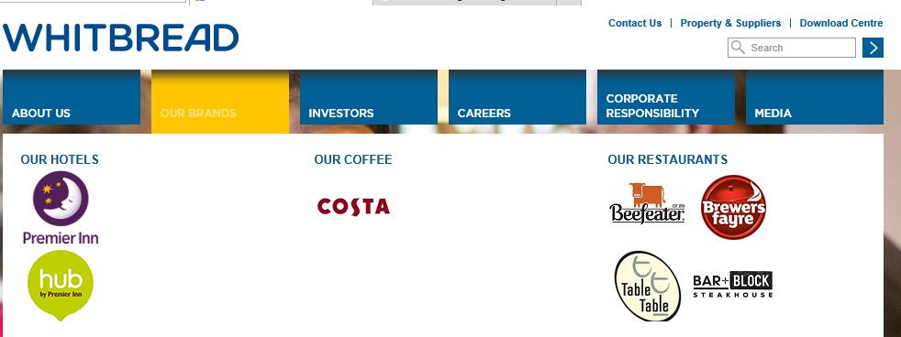


Successful and Unsuccessful Change
Successful | Unsuccessful
Whitbread succeeded by realising that beer may not always be attractive long term and therefore moved into Costa Coffee and Premier Inn, building on its strengths in the service industry. | Kodak and Nokia both failed to manage change well as they missed the big changes in their markets.

Slide 35
Value of a Flexible Organisation
The ability to prepare for or respond to change depends on the flexibility of the organisation.
Managers seek to build a business that is agile and can adapt and reshape to internal or external change.
But how?
Restructuring
Delayering
Using flexible employment contracts

Slide 36
Restructuring
It may be that an organisation is initially organise on functional areas, e.g. marketing, finance, operations. However, as the organisation expands internationally it may be more logical and appropriate to reorganise and base the structure on different geographical regions.
Why?
By doing this the regional managers can focus on and respond more quickly to local changes and demand, making the business more flexible.

Slide 37
Delayering
If layers of hierarchy exist it may be that a business needs to remove levels of hierarchy if costs need to be cut and if it needs to reduce the distance from the top to the bottom of the organisation

Slide 38

Delayering
Harriet Green delayered when she took over Thomas Cook in 2012
She felt the communication between customers and senior managers had to go through too many levels of hierarchy
This cut management costs but, importantly, could lead to faster decision making and more decision making by those who are closer to their customers
Why might this be important now that more changes have happened in the market?

Slide 39
Flexible Employment Contracts
Flexibility can be helped by having broadly defined employment contracts rather than defining very precisely what an employee has to do
This enables the business to move employees around as and when they are needed
They can be switched from one task to another
They can be moved from one location to another as demand patterns change or as requirements change

Slide 40
Flexible Employment Contracts
If contracts are tightly defined it can be difficult for managers to adjust to different situations as employees can argue “that’s not my job”

Slide 41

Flexible Employment Contracts
This can also include the use of temporary employees or agency workers
This enables a business to increase or decrease its labour workforce when needed
Zero hour contracts can help with this

Slide 42
Flexible Working
Flexible working is becoming more popular where employees can choose their own working hours.
This has been said to increased motivation and productivity
In America some companies offer unlimited holiday! Why?

Slide 43


Slide 44
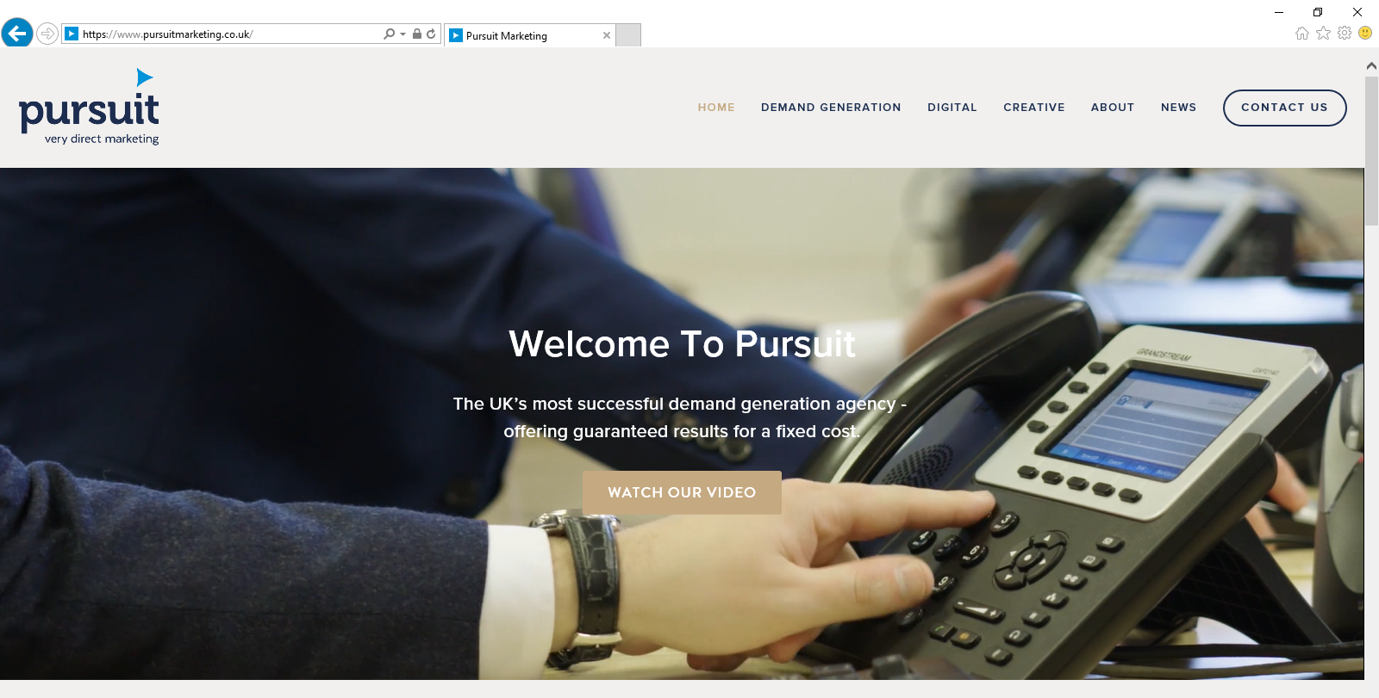
Example of Flexible Working
Pursuit Marketing – Glasgow
http://www.bbc.co.uk/news/business-42739681

Slide 45
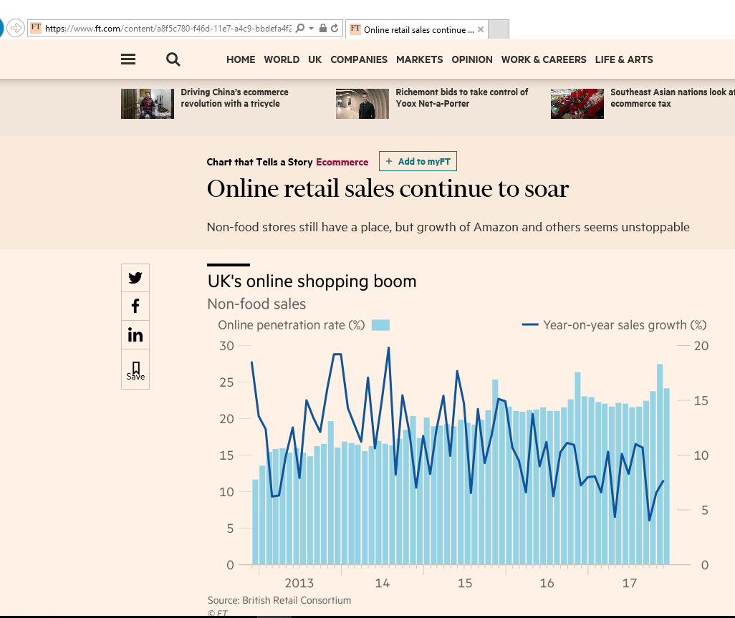
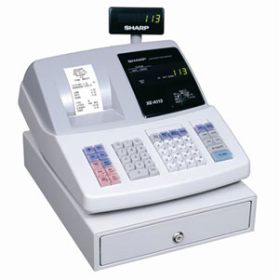
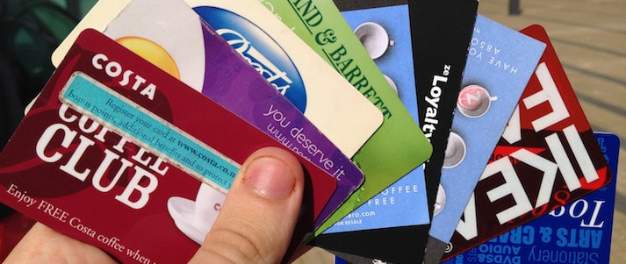
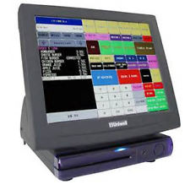
Value of Managing Information and Knowledge
Information is a key resource these days. Developments in technology have made it easier to collect data
to

Slide 46
Value of Managing Information and Knowledge
They also have access to vast amounts of data external to the business such as economy, companies, population patterns, market patterns etc.

Slide 47
Value of Managing Information and Knowledge
This means that they can:
Identify changes before or as they happen
Develop suitable strategies to respond or to prepare
Evaluate the effectiveness of their strategies

Slide 48
Kotter and Schlesinger
Whilst some employees may welcome change, others will almost inevitably resist
Kotter and Schlesinger have two theories where they outline:
Reasons for Resistance to Change
Overcoming Resistance to Change

Slide 49
Kotter and Schlesinger
Resistance to Change
Reasons for Resistance to Change
Self interest
Prefer the present situation
Different Assessment
Misunderstanding

Slide 50
Kotter and Schlesinger
Overcoming Resistance to Change
Overcoming for Resistance to Change
Education and Communication
Facilitation and support
Participation and Involvement
Manipulation and co-option
Negotiation and bargaining
Explicit and implicit coercion

Slide 51
